Slide 1
Understanding Layer 3 Redundancy

Slide 2
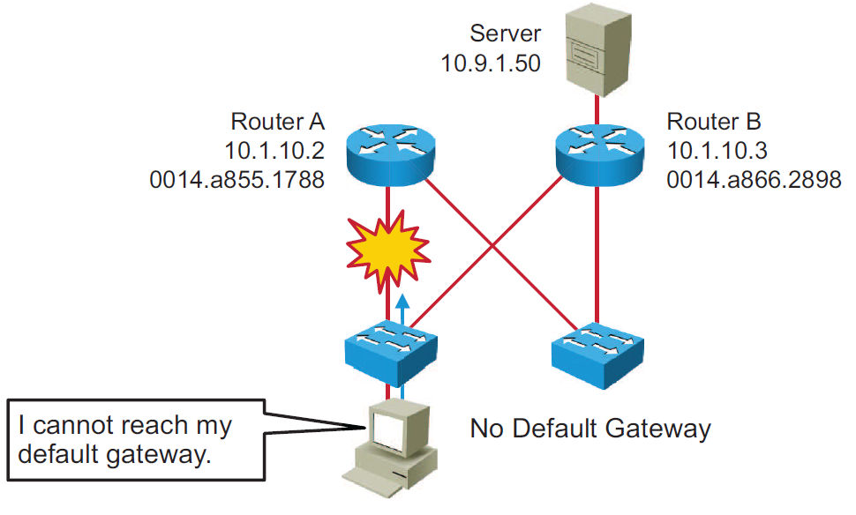
The Need for Default Gateway Redundancy

Slide 3
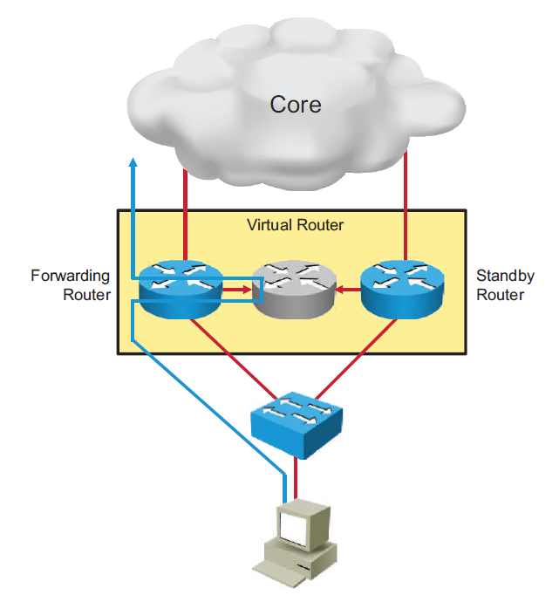
Default Gateway Redundancy

Slide 4
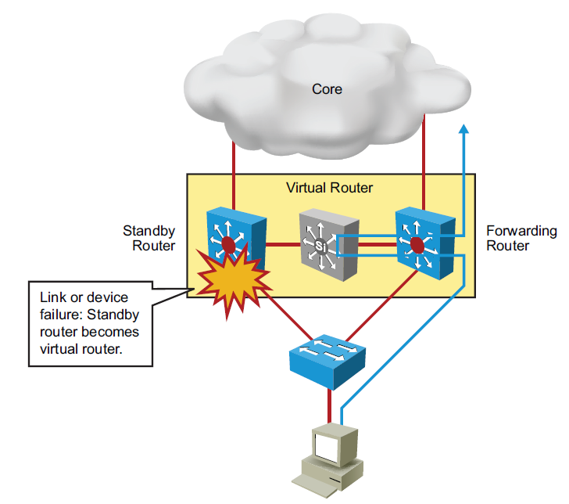
Default Gateway Redundancy (Cont.)

Slide 5
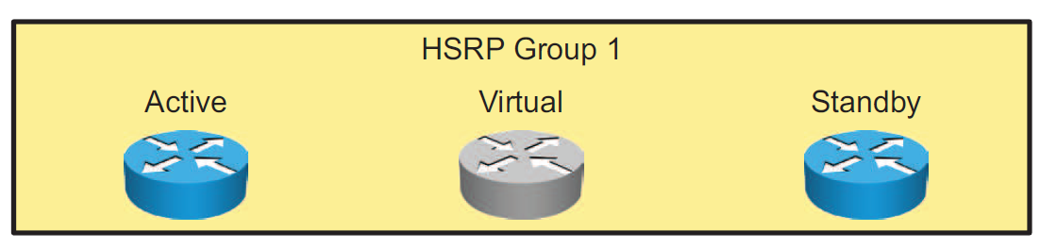
HSRP
HSRP defines a group of routers -- one active and one standby.
Virtual IP and MAC addresses are shared between the two routers.
To verify HSRP state, use the show standby command.
HSRP is Cisco proprietary, and VRRP is a standard protocol.

Slide 6
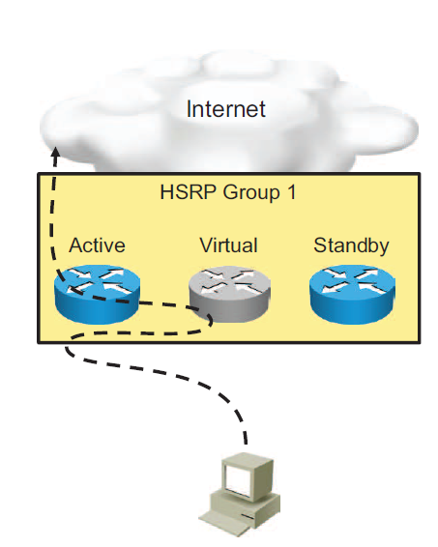
HSRP (Cont.)
Active router:
  Responds to default gateway ARP requests with the virtual router MAC address
  Assumes active forwarding of packets for the virtual router
  Sends hello messages
  Knows the virtual router IP address
Standby Router
  Listens for periodic hello messages
  Assumes active forwarding of packets if it does not hear from active router

Slide 7
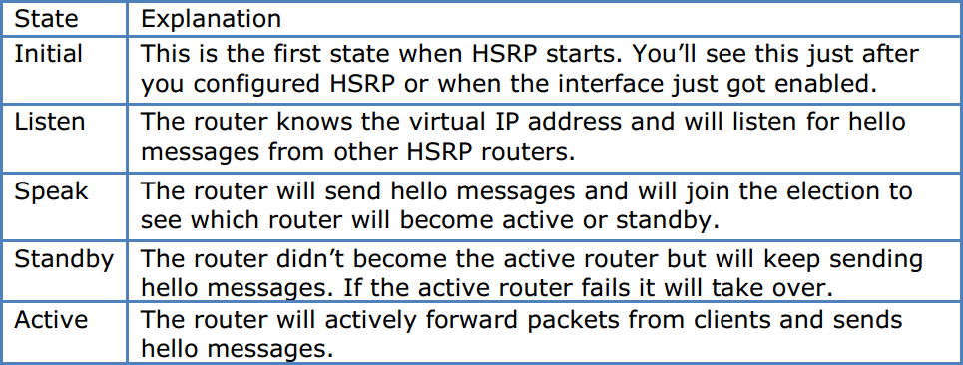
HSRP states

Slide 8

Configuring HSRP
Routers A and B are configured with priorities of 110 and 90, respectively. The configuration of Router A is displayed. A similar configuration is required on Router B.
The preempt keyword ensures that Router A will be the HSRP active router as long its interface is active and sending hellos.
HSRP
Group 1
Router A
Priority
110
Router B
Priority
90
RouterA(config)# interface GigabitEthernet0/0
RouterA(config-if)# ip address 10.1.10.2 255.255.255.0
RouterA(config-if)# standby 1 ip 10.1.10.1
RouterA(config-if)# standby 1 priority 110
RouterA(config-if)# standby 1 preempt

Slide 9
HSRP Verification
Use the show standby command to verify the HSRP state.
RouterA# show standby
GigabitEthernet0/0 - Group 1 (version 2)
State is Active
2 state changes, last state change 00:00:18
Virtual IP address is 10.1.10.1
Active virtual MAC address is 0000.0C9F.F001
Local virtual MAC address is 0000.0C9F.F001 (v2 default)
Hello time 3 sec, hold time 10 sec
Next hello sent in 2.278 secs
Preemption enabled
Active router is local
Standby router is 10.1.10.3, priority 90 (expires in 9 sec)
Priority 110 (configured 110)
Group name is hsrp-Gig0/0-1 (default)

Slide 10
HSRP Verification (Cont.)
The show standby brief command displays a summary of the HSRP configurations.
RouterA# show standby brief
P indicates configured to preempt.
|
Interface Grp Pri P State Active Standby Virtual IP
Gig0/0 1 110 P Active local 10.1.10.3 10.1.10.1
RouterB# show standby brief
P indicates configured to preempt.
|
Interface Grp Pri P State Active Standby Virtual IP
Gig0/0 1 90 P Standby 10.1.10.2 local 10.1.10.1

Slide 11
HSRP and IP SLA Tracking
172.16.12.2
HSRP
Group 1
Router A
Priority
110
Router B
Priority
90
RouterA(config)#ip sla 1
RouterA(config-sla)#icmp-echo 172.16.12.2
RouterA(config)#ip sla schedule 1 start-time now life forever
RouterA(config)#track 1 ip sla 1 reachability
RouterA(config)#interface GigabitEthernet0/0
RouterA(config-if)#standby 1 track 1 decrement 30

Slide 12
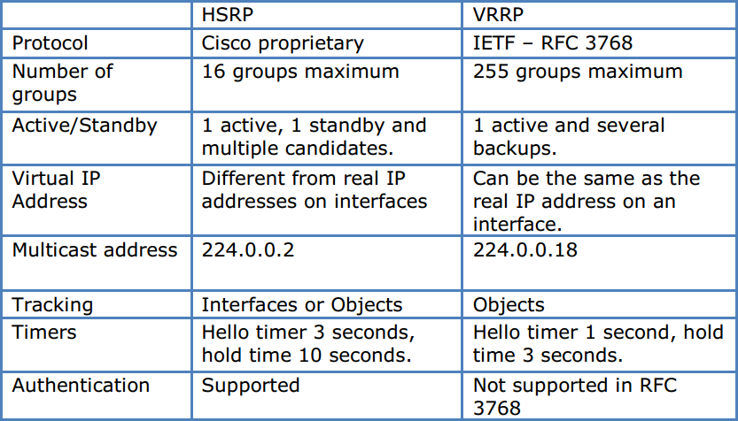
HSRP vs. VRRP

Slide 13
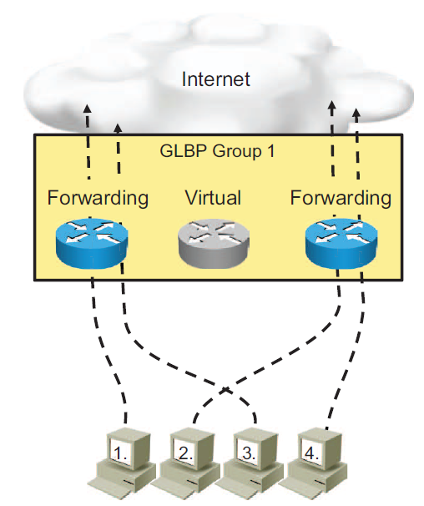
Gateway Load Balancing Protocol
Allows full use of resources on all devices without the administrative burden of creating multiple groups
Provides a single virtual IP address and multiple virtual MAC addresses
Routes traffic to single gateway distributed across routers
Provides automatic rerouting in the event of any failure

Slide 14



phamthaikhanh@gmail.com
This Photo by Unknown Author is licensed under CC BY-NC

